Slide 1

ARIC SMB August 2022

Slide 2
Agenda
Minutes and actions of the SMB held on 15th of April 2022
Draft document for marketing ARIC
ARIC Commercialization Assessment meeting with Dr. Sami Bashir
(Dr. Sami Bashir guest, to join)
4. Status of additive manufacturing lab
5. Update on staffing issues in ARIC and retention of ARIC resources
6. Update regarding the KUKA robot in ARIC (DG World)
7. Brief updates on the projects in ARIC
8. KPIs for 2022
9. ARIC post-November 2022 (funding, leadership etc.)
10. AOB

Slide 3
Outcome & Action Items (to be completed prior to next SMB)
Dr. Wesley to ask Gordon on the rates of metallic printing per hour
Dr. Steve to communicate with Dr. Peter regarding the 3D printing hiring issue
Dr. Wesley to invite Mr. Sayed to join the next monthly meeting to present the draft strategy
Dr. Wesley to follow up with Blake on Abdulla’s increment
Dr. Abdelqader to coordinate with the Provost (re. Dr. Yusra), Dr. Yahya to send an email to Dr. Abdelqader regarding SANAD Proposal
Dr. Abdelqader to work with Dr. Wesley to organized R&D review days and have Strata, SANAD and ARIC to present the projects they are doing

Slide 4
Wesley,
This sounds very high, we have found that if you try to repay the capital you are only going to drive people away. Since the machine was not bought as a commercial venture I would look only at recovering actual operating costs, (material, maintenance and labour) for internal work. Depending on the customer for external work, see how you can load that to achieve some payback.
You need to get the ship moving before you can steer it.
Do you have an idea as to the deposition rate for the printer, the specs say 100cmᶾ per hour, do you achieve that.
You should probably have a rate that is dependent on the material being printed.
Best Regards,

Slide 5
From Wafa in HR
Dear Team,
It was communicated to research team that research increment will follow the staff increment cycle which is normally before end of the year properly November and subject to management approval. We can get the nominations from research and development office, do the required evaluation and get the required approvals to proceed.
Thank you.

Slide 6

2. Draft document for marketing ARIC
Advanced Research & Innovation Center – ARIC Digital
Marketing and publicity plan

Slide 7


ARIC Digital: Intelligent Robotic Manufacturing
Publicizing and marketing at ARIC Digital
Motivation and Objectives:
Create awareness about ARIC digital projects and achievements.
Publicize the contributions of ARIC stakeholders in supporting national technology development.
Boost impact of ARIC publications by creating wider audience base.
Attract technology partners from UAE and abroad.
Create local network for intelligent manufacturing technologies, inline with the UAE’s industrialization strategy.
Facilitate commercialization of ARIC technologies.

Slide 8
ARIC Digital: Intelligent Robotic Manufacturing
Publicizing and marketing at ARIC Digital
Means and Channels
Stand-alone ARIC LinkedIn page:
For regular bi-weekly updates on: technology development, papers, patents, important lab visits, etc …
Local and International Conference/Exhibitions:
Target a single conference and a single exhibition:
Dubai Airshow
Global Aerospace Summit
Global Manufacturing & Industrialization Summit
…
Press releases in local media:
Target two press releases a year including news articles and promotional videos to report major milestones

Slide 9
ARIC Digital: Intelligent Robotic Manufacturing
Publicizing and marketing at ARIC Digital
Suggested Content for LinkedIn page:
# | Content Description | Frequency | Notes
1 | Videos of technology demonstrations at ARIC with description of technology and impact. This includes high-TRL and low-TRL projects like: Multi-purpose robotic machining end-effector Visual tactile sensing for machining Automated inspection of aeroplane components Automated sorting for engine blades AI for robotic manipulation | Monthly | Each sub-team within ARIC will be responsible for creating these technology demonstrations (3-4 months period for each sub-team)
2 | Interviews / testimonials from industrial partners | Quarterly | Testimonials STRATA, SANAD, Lufthansa, etc … on the impact and relevance of ARIC project to industrial sector
3 | Updates on papers/patents/publications from ARIC | Quarterly | Highlighting novelty and impact
4 | Summary video for student projects | Twice a year | Upon completion of projects. Including undergraduate and graduate students

Slide 10
ARIC Digital: Intelligent Robotic Manufacturing
Publicizing and marketing at ARIC Digital
Required Resources:
Manager for social media (Linkedin) page to (15% allocation or through 3’rd party):
Edit videos and ensure quality
Write and edit scripts for posts
Ensure timely updates of the page
Contact local media outlets
Respond to inquiries and messages on LinkedIn page
Budget to attend exhibitions and conferences (~15,000 AED per-year)

Slide 11
3. ARIC Commercialization Assessment meeting with Dr. Sami Bashir

Slide 12
4. Additive Manufacturing Lab
By: Tareq Farrah

Slide 13
Lab Operational Summary: July 2022
Lab status ​ | Sample build for ARIC department has been build successfully by EOS M400-4. Data Pre-Processing for ADAM center, Design for new builds feedback. Setting up a new communication (local network domain) and cable ducting for EOSM400-4. Post-process for ARIC samples is completed.
Procurement ​ | EOS M400-4 data preparation and advanced user training in Muncih,Germany have been submitted to HR. Quill Vogue Powder Wash (Water Jet) quotation has been submitted. Preventive Maintenance for Ceramic Printer Maintenance Contract PO number 8472108769 issued.
Maintenance ​ | Fine Filter switch issue is resolved. The emergency cut-off electricity switch issue is resolved by FM. Recoater adjustment for the next build. Wet separator cleaning (liquid container and the moisture separator)
Safety ​ | Emergency cut-off switch keys will be provided to EHS and KU Security. Hazardous waste (condensate powder) was collected by the contractor. RL EHS operations updates > ongoing.
Other​ | Funded Research Projects list is prepared.

Slide 14
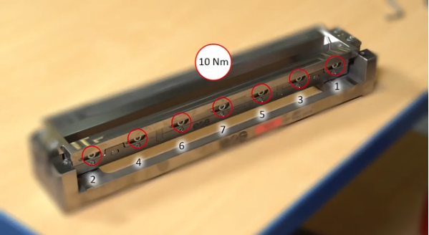
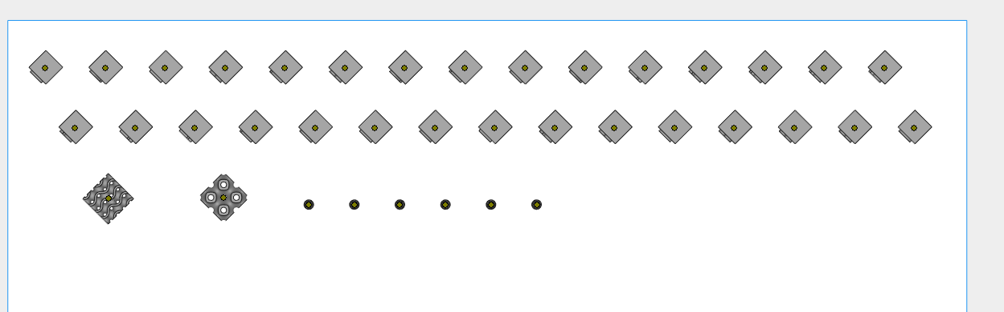
EOS M400-4 Operation
Safety concept
Safe operation (Machine, Materials, Inert gas and cleaning)
Safety warnings on the machine.
Hazard and safety measures.
Pre-Operation
Assembly the soft recoater.
Fitting/replacing elastomer lips.
Fit soft recoating holder to the recoater module.
Tighten in the correct sequence.
Cleaning the walls of the process chamber.
Clean the laser lenses with IPA wipes.
Prepare the building layout using Magics software.
New Sense select the machine and the baseplate.
Load STL files to the magics software.
Automatic placement of the loaded parts.
Relocate each part of the build in the right orientation according to the provided layout.
Save the project.
Import the save project to EOSPrint to start the print configuration.
EOS M400-4 Soft recoater tighten
Magics layout

Slide 15
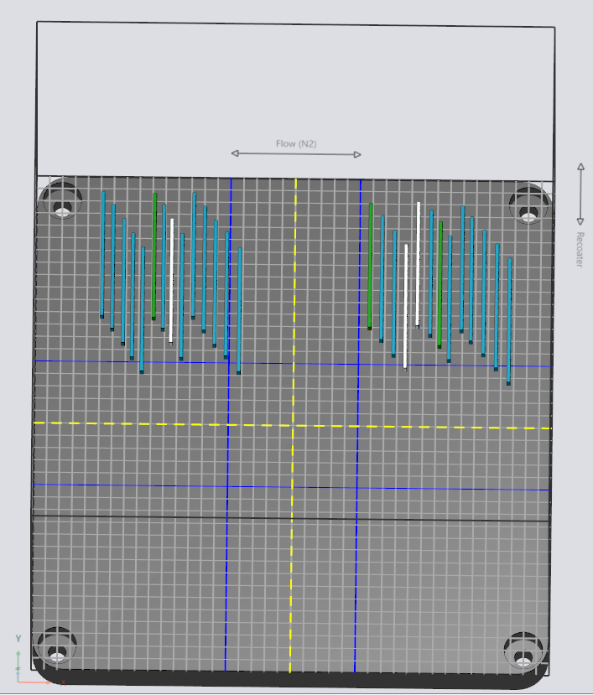
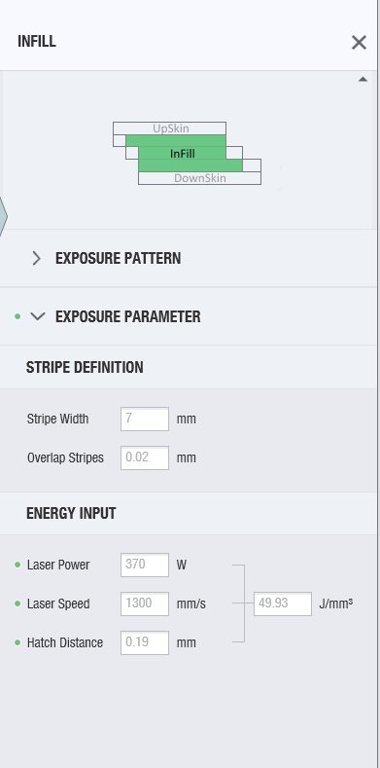
Exposure Set Parameters and EOS JOB in EOS Print
Setting exposure parameters
Choose the imported parts.
Insert the infill exposure parameters.
Placement of the parts in a correct orientation.
Ensure right distance between each part.
Save the working job.
Export the EOS job to the EOS machine by Ethernet communication.
Ensure the right EOS job in the building task of EOS machine.
Start the building process.
Monitor remotely the building process using the EOSState software .
TPMS layout in EOSPrint (Pre-process)
Exposure Set Parameters

Slide 16
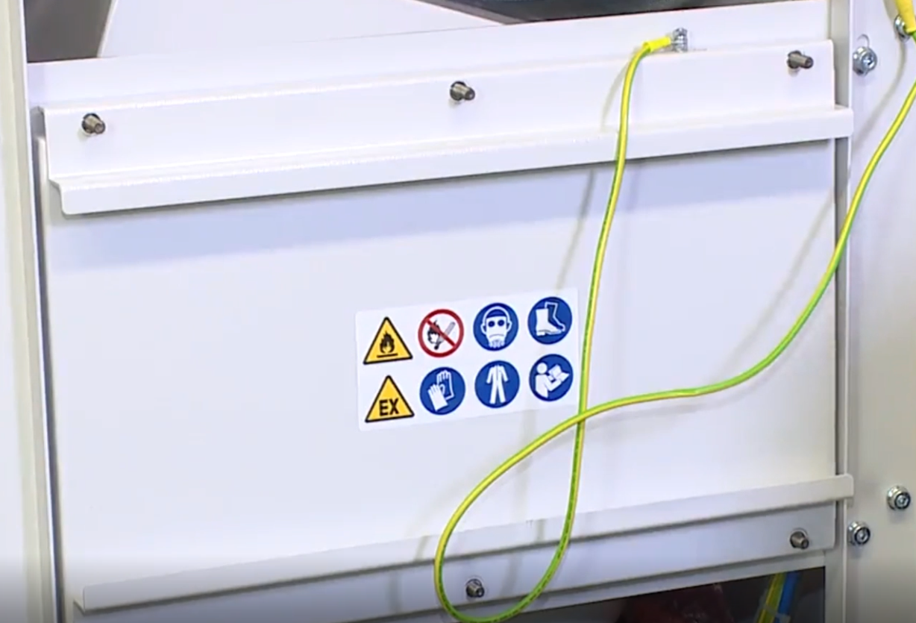
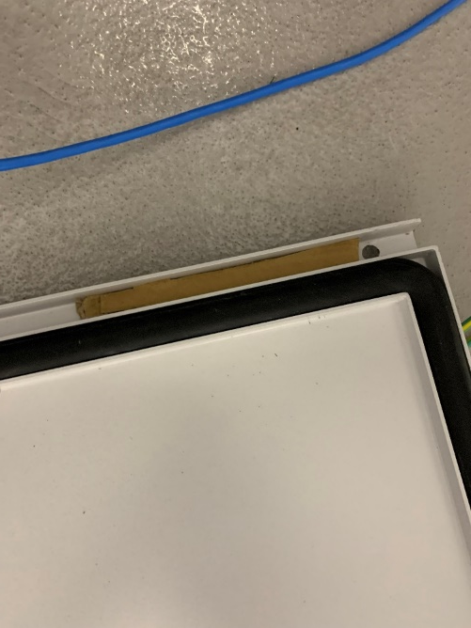
EOS M400-4 Maintenance
Fine Filter housing issue resolved procedure
Hazard and safety measures.
Removing fine filter housing cover.
Add a piece of carton to the fine filter switch.
Tighten the housing cover screws.
Fine Filter
Piece of carton

Slide 17
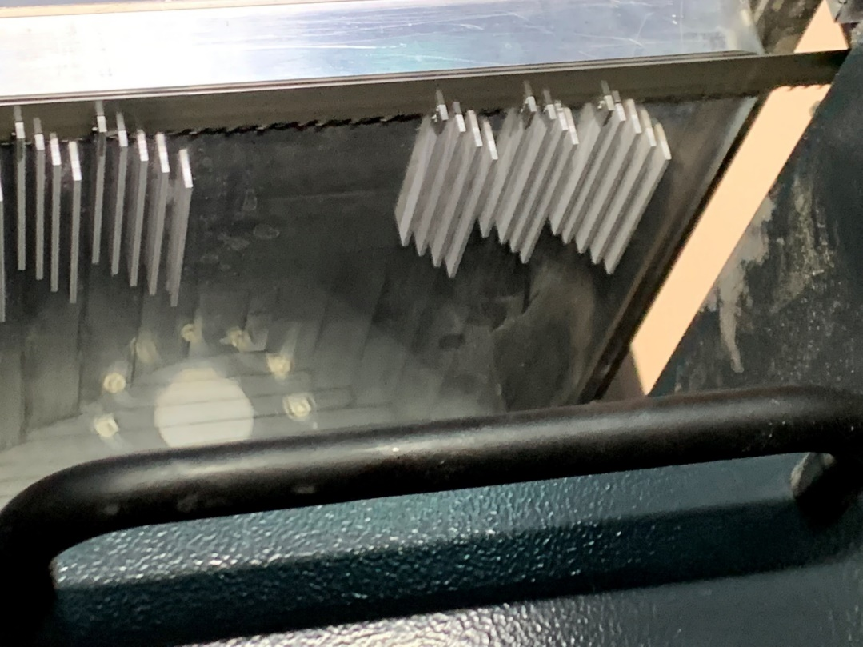
Post-Process (Kasto Bandsaw)
Cutting-off builds from the baseplate
Choose the material to be cut.
Locate the baseplate on the platform.
Ensure the tightness of the baseplate screws with the machine platform.
Manual ensure the saw location to cut less than 3mm thickness of the build.
Keep monitoring the cutting procedure of the machine.
Band saw

Slide 18
5. Update on staffing issues in ARIC and retention of ARIC resources
Lewis Kindleyside left KU on the 16th of June 2022.
Mr. Mohammed Ramadan (RA) joined on the 15th of June 2022.
Dr. Yusra is about to commence her post-doctoral research position
Also, Mohammed Ahmed Ali (SANAD project), Oussama AbdulHay (STRATA project) Ibrahim Mohammed (fatigue of 3D printed parts) and Nora Alahmed (composites manufacturing) joined us as PhD students Islam Mohammed (MSc,STRATA project) has also joined.

Slide 19
6. Update regarding the KUKA robot in ARIC (DG World)

Slide 20
The Analysis of Process-induced Deformation of CF\PEKK Aerostructures
Mariam Ahmed Al-Dhaheri
Dr. Rehan Umer (Main Advisor)
Prof. Wesley Cantwell (Co-Advisor)

Slide 21
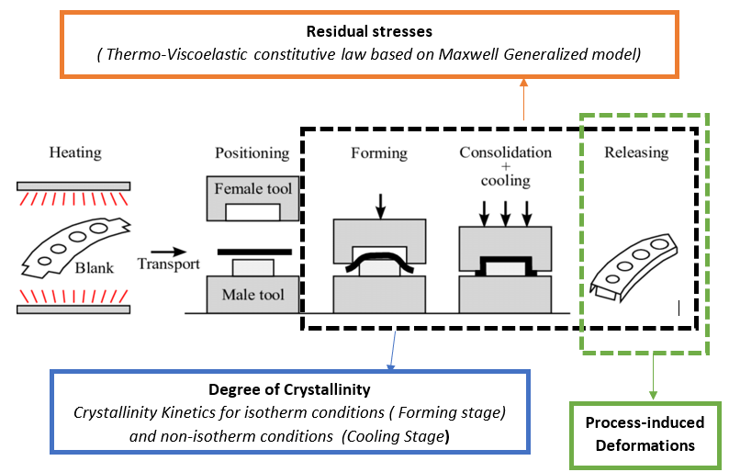
RESEARCH AIM
To predict process-induced deformation of a Thermorheological complex material, using a linear thermo-viscoelastic constitutive model that considers the effect of temperature and degree of crystallinity, for curved structures.

Slide 22
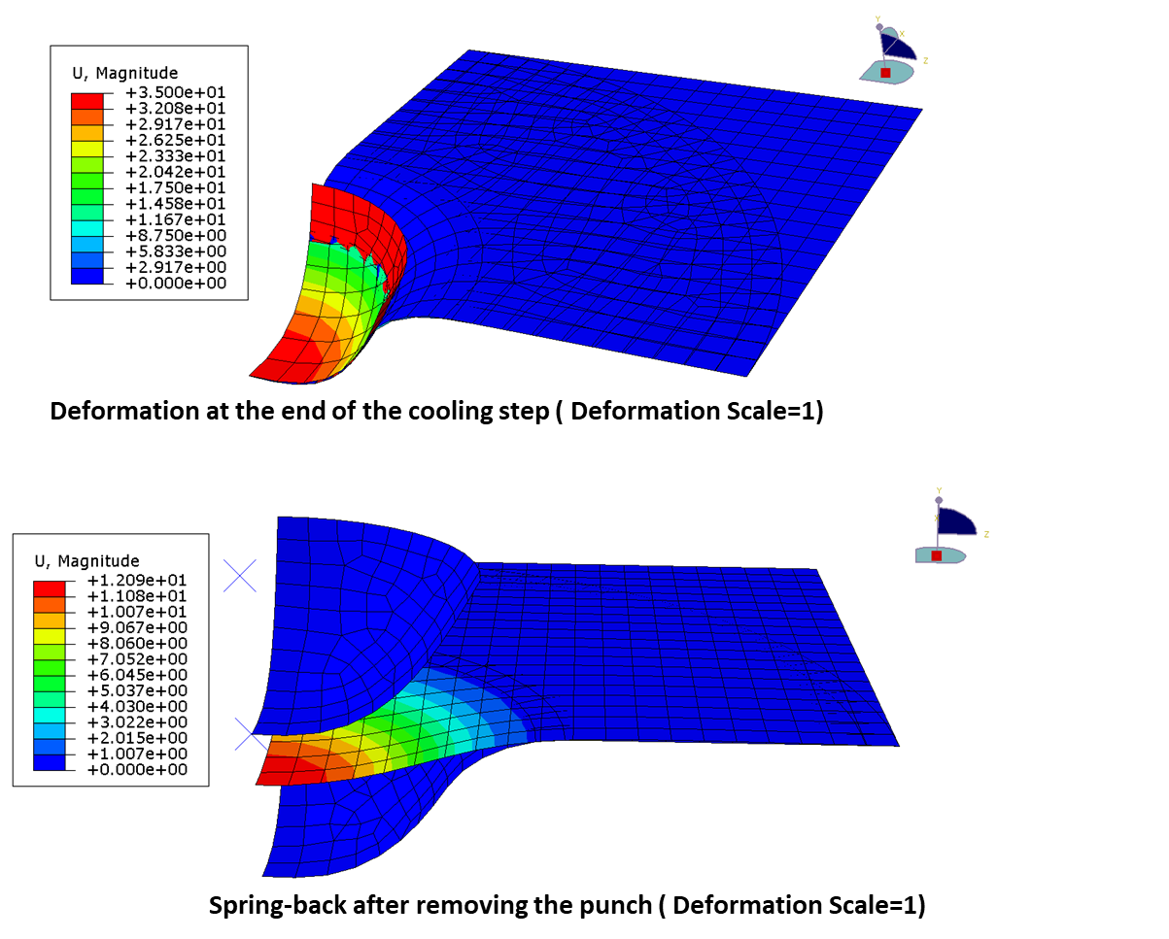
RESEARCH OVERVIEW
THERMO-VISCOLEASTIC CHARACTERIZATION
TVE model
FINITE ELEMENT MODEL
(Thermoforming process simulation)
Experimental validation
(Thermoforming process)
Numerical Studies
(Thermoforming process)

Slide 23
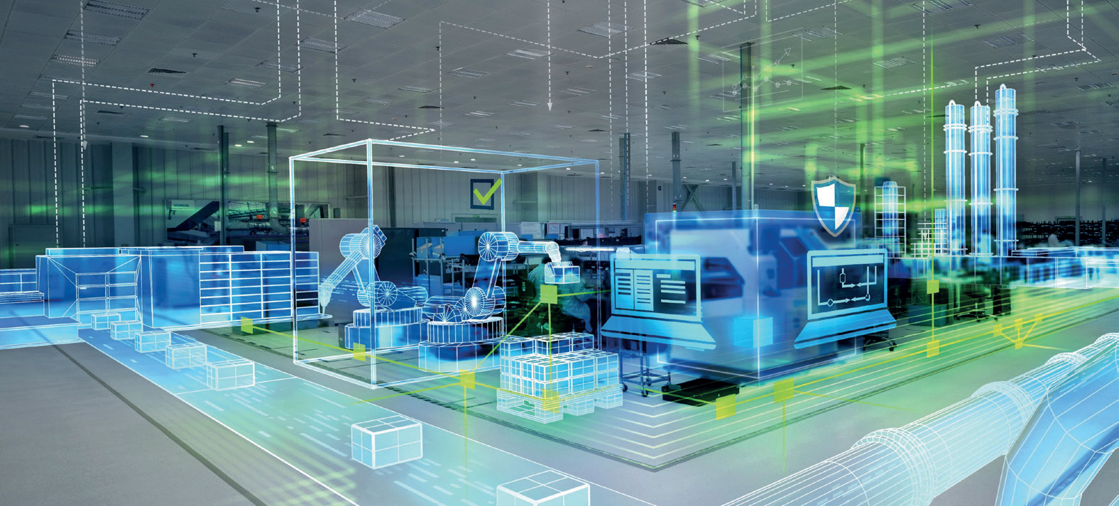
The Factory of the Future
Phase 1 - Aircraft Ribs Hub
Q2 2022 - 25 MAY
High level

Slide 24
Next steps
Buy in of strategic plan from senior management
Generate Statement of Work
Identify test case (Wing ribs, Control surface ribs, Spars, Spoilers, etc.)
Gather requirements (Stakeholder, functional, structural, other associated)
Generate requirements matrix with Verification & Validation plans (w.r.t phases)
Hone in on SW (commercial, open-source, etc.) for procurement
Gather historical data from current manufacturing processes (Quality, Work instructions, etc.)
Identify potential MSc, PhD projects and hone in on candidates
Appoint Research Engineers and Research Fellows
Execute project

Slide 25
2022 KPI’s
Progress relative to targets will be presented in next month’s update.
#1 Number of Q1 papers published through ARIC’s team: (Target: 1 per USD $50k invested in research)
5 papers have been published in 2022
#2 Number of problems being solved for industry (Target: 3)
New activities on the vision-based manufacturing research activity
Deburring End-Effector.
Painting End-Effector
Blind Riveting End-Effector
Counter-sink inspection.
#3 Number of UAE nationals deployed on ARIC’s (Target: 6 including undergraduate activities)
8 students currently on SDP projects in 2022.
#4 Number of patents filed (Target: 4 disclosures filed)
1 patent under review
#5 Number of articles in local/international media highlighting ARIC’s role/achievements KU (Target: 3)
Posted details of the turbine blade repair project on LinkedIn.
Mariam Al-Dhaheri’s research project will be covered in the Innovation Forward newsletter
The University is publicizing work on resin-infused thermoplastics.

Slide 26
9. ARIC post-November 2022 (funding, leadership etc.)

Slide 27
AOB

